Slide 1
Highly Effective Professional Writing
Day One—[Month] _ _, 20_ _
[Organization]
[Location]

Slide 2
Some Thoughts About Writing
“Read the Roman-Raphaelson book on writing. Read it three times.
Write the way you talk. Naturally.
Use short words, short sentences and short paragraphs.
Never use jargon words like reconceptualize, demassification, attitudinally, judgmentally, etc.
Never write more than two pages on any subject.
Check your quotations.
Never send a letter or a memo on the day you write it. Read it aloud the next morning — and then edit it.
If it is something important, get a colleague to improve it.
Before you send your letter or your memo, make sure it is crystal clear what you want the recipient to do.
If you want ACTION, don’t write. Go and tell the person what you want.”
David Ogilvy,
Ogilvy & Mather
“The Father of
Advertising”

Slide 3
Some Thoughts About Writing, cont’d.
“The only way some people know you is through your writing. It can be your most frequent point of contact, or your only one, with people important to your career–major customers, senior clients, your own top management. To those women and men, your writing is you. It reveals how your mind works. Is it forceful or fatuous, deft or clumsy, crisp or soggy? Readers who don’t know you judge you from the evidence of your writing.”
Roman &
Raphaelson
Writing That
Works

Slide 4
Causes of (and Solutions for) Ineffective Professional Writing

Slide 5
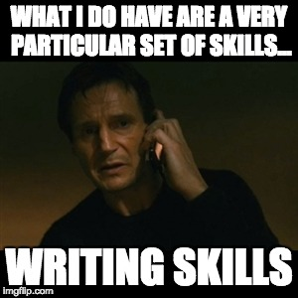
A Situational Approach…
The focus of writing instruction has shifted from an academic “one size fits all” approach to a more flexible one that takes into account the “rhetorical situation,” or the context (such as audience & purpose) of each specific document.

Slide 6
…That Recognizes Repeated Situations
Purpose & Audience >
Medium >
(Print, Online, Video, Audio, etc.)
Genre
(A response to a repeated situation that becomes a standardized type of document with its own format & rules)

Slide 7
Overview of Topics Covered
Best Writing Practices
Audience Awareness
Adjusting Stance/Tone
Specific Skill Sets
Organization
Argumentation
Word Choice/Sentence Structure
RCB-Specific Documents
Internal & External Emails/Memos
Minutes
Policies/Procedures
Reports/Analyses
Marketing Materials/Press Releases

Slide 8
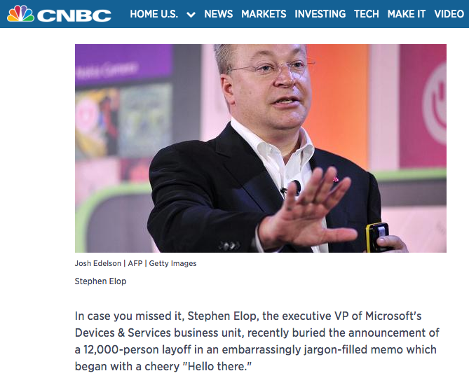
The Importance of Audience Awareness
http://www.cnbc.com/2014/07/21/how-microsoft-mangled-a-layoff-memocommentary.html

Slide 9
Audience Awareness, cont’d.
0 References to “empathy,” “regret,” “disappointment,” “concern,” or references to any ethical or strategic dilemma
31 Uses of or synonyms for the words “plans,” “winning,” “building,” or “shifting”
0 Uses of or synonyms for the words “consider,” “understand,” “sensitive,” “aware,” or “disappoint”
35 Uses of or synonyms for the words “product,” “alignment” and “focus”
0 Uses of the word “accountable”
2 Uses of the word “responsible” (in the context of business units who will own key functions of the newly “right-sized” business)
0 Uses of or synonyms for the words “relationship”, “friends”, “colleagues”
18 Uses of the word “team”
0 Uses of the words “I,” “me,” or “you”
40 Uses of the word “we” (in the context of who made the layoff decision)
http://moementum.com/work-smart-blog/the-microsoft-layoff-letter-a-239-word-alternative/

Slide 10
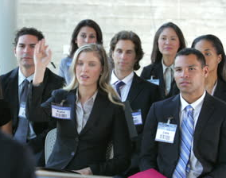
Know Your Audience
Shareholders
Executive Team Members
Management
Fellow Employees
Land/Business Owners
Client Organizations
Loan Applicants
Bank Customers
General Public
_______________
_______________

Slide 11
Proximity
Subject Audience
What Changes?
_______________
_______________
_______________
_______________
_______________
Author Author

Slide 12
Word Bank: The Writer’s Toolkit
Genre A specific type/format of document
Organization Location of main idea; doc. design/visuals
Stance Presumed relationship with audience
Framing Amount of context/background info.
Argumentation Types of arguments/evidence used
Tone Author’s attitude toward subject & aud.
Register Level of formality (includes POV, slang)
Word Choice Use of jargon, as well as…
Hedges Objective, limited terms (“seems,” etc.)
Attitude Markers Emotionally expressive words

Slide 13
Essential Questions
For whom is this document intended?
Why would the reader want to read this document?
What main points is it most important I make?
By when do any necessary tasks or responses need to be done?
If I could convey only one sentence to this reader, what would it be?

Slide 14
Individual Assignment
Deadline: ____day, _ _/_ _ by close of business
Email to:
contact@milesminiaci.com
Draft of a recent or current document
Reflection memo

