Slide 1
Mastering Grammar
Day One—[Month] _ _, 20_ _
[Organization]
[Location]

Slide 2
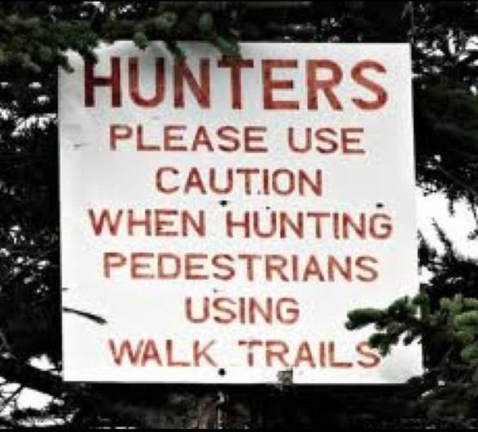
Grammar, Mechanics, and Usage
Sentence Length
Grammar
Punctuation
Further Mechanics
Proofreading Tips

Slide 3
Sentence Length
Overly lengthy sentences may be caused by:
Long introductory phrases
Long proper nouns or noun phrases
General wordiness or redundancy

Slide 4
Move, Condense, or Eliminate Introductory Phrases
“Given the limited availability of water quality data, as well as uncertainty regarding bacteria sources and behavior, the contractor will continue to collect water quality data.”
“The contractor will continue to collect water quality data, given the limited availability of water quality data, as well as uncertainty regarding bacteria sources and behavior.”

Slide 5
Beginning with the Main Clause
Main Clause:
A human or concrete subject and its accompanying vivid action verb.
“We reviewed the language in the permit.”

Slide 6
Eliminating Wordiness
“Vigorous writing is concise. A sentence should contain no unnecessary words, a paragraph no unnecessary sentences, for the same reason that a drawing should have no unnecessary lines and a machine no unnecessary parts. This requires not that the writer make all his sentences short, or that he avoid all detail and treat his subjects only in outline, but that every word tell.”
—Strunk & White, The Elements of Style
“Good prose is like a window pane.”
—George Orwell, Why I Write

Slide 7
Eliminating Wordiness, cont’d.
StyleWriter, the copy-editing software company, compiled word counts for sentence length in major media outlets:
Time: 15 to 23 – Average: 19
The Washington Post: 17 to 23 – Average: 20 Government News Releases: 16 to 33 – Average: 27 Government Websites: 24 to 36 – Average: 27

Slide 8
The Importance of Concision
What the Scientist Said…
What He or She Meant…
It has long been known that. . .
Of great importance. . .
Typical results are shown . . .
It is suggested that; It is believed that;
It is generally believed that. . .
Additional work will be required before a complete understanding. . .
A quantitative theory to account for these results has not been formulated.
Correct within an order of magnitude
I haven't bothered to look up the original reference, but. . .
Interesting to me . . .
The best results are shown . . .
I think. . .
A couple of other folks think so, too.
I don't understand it.
I can't think of one, and neither can anyone else.
Wrong.
—Matthews, et al, Successful Scientific Writing

Slide 9
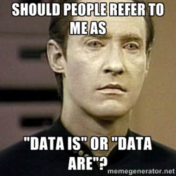
Subject/Verb Agreement
Factors to consider…
Intervening Phrases
Either/Or and Neither/Nor
Criterion/Criteria and Datum/Data
Collective Nouns
Indefinite Pronouns

Slide 10
Parallel Construction
Longer items in a serial list should match grammatically. This includes matching verb and noun forms, as well as accompanying articles, prepositions, and infinitives.
Using parallel structure will help to control long sentences and to add variety and style.
“The site must be stabilized as necessary to enhance wildlife habitat values and to prevent erosion and sedimentation.”

Slide 11
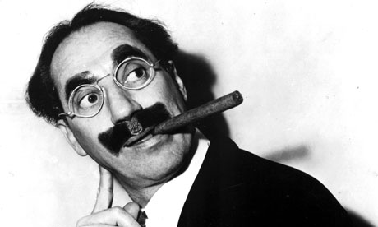
Modifiers
Place modifiers as close as possible to the words they are intended to modify.
This helps to avoid misplaced or “dangling” modifiers.
“One morning I shot an elephant in my pajamas. How he got in my pajamas, I’ll never know.”
—Groucho Marx

Slide 12
Adjective Clauses
Adjective clauses are most commonly connected to sentences with “that” or “which” (“who” if referring to a person).
That is used when a clause is essential to the meaning of the sentence.
“Languages that use unfamiliar sounds are especially difficult to learn.”
Which is used when a clause is not essential and could be removed.
“English, which has more words in its vocabulary than any other language, is especially difficult to learn.”
In some cases, adjective clauses can be connected without using “that” or “which.”
“This section of the report focuses on enclosed bays, which are indentations along the coast that enclose an area of oceanic water.”

Slide 13
Reducing Adjective Clauses
Verbal Phrases
Verbal phrases begin with a verb form, but are used as modifiers.
“This compliance data, which was retrieved from GeoTracker database, is an important resource to both regulators and the public.”
Appositive Phrases
Appositive phrases are noun-based phrases that rename a subject or object.
“The motion was seconded by Spivy-Weber, who is the Board ViceChair.”

Slide 14
Common Uses of Commas
Combining sentences with conjunctions (and, but, or, etc.)
“This is an informational item only, and no decisions will be made.”
Setting off phrases and clauses
Transition Words
Adverbs
Time Markers
“In the near future, the Board will propose additional amendments to address other high priority pesticides.”
Listing items in a series
The “Oxford Comma”
“The conservation of our water supply is essential to public health, wildlife, and agriculture.”
Displaying Dates

Slide 15
Semicolons vs. Colons
A semicolon joins two independent clauses (i.e., sentences).
Sentence + Semicolon + Sentence
“It is no longer feasible to achieve historic conditions; rather, efforts must focus on rehabilitation of the existing site to its best achievable structure.”
A colon joins a sentence to list, definition, or example.
Sentence + Colon + List, Definition, Example
“The most concentrated sediments in the area are as follows: sediment, pathogens, PCBs, and mercury. ”

Slide 16
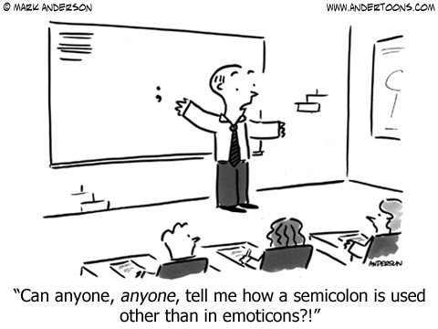
Semicolons, cont’d.
An additional use of semicolons to separate items in a serial list that may already contain internal commas:
“Beneficial uses include recreation; navigation; and preservation of fish, wildlife, and other aquatic resources.”
“Further board meetings were held on December 16, 2014; January 6, 2015; and January 20, 2015.”

Slide 17
Other Punctuation
Apostrophes
Use an apostrophe to indicate possession. Do not use an apostrophe to indicate plural items: 2000s, WRCEs.
Add an apostrophe and ‘s’ to words that end in ‘s’ when singular.
“Miles’s pop culture references were restricted to his PowerPoint slides.”
Quotation Marks
Periods and commas always go inside the closing quotation mark; other punctuation goes inside only if part of the original quotation.
Use single quotation marks only to signify a quotation within a quotation.

Slide 18
Dates & Numbers
Spell out numbers from zero to ten. Use numerals for 11 and above. If you have both in the same sentence or discussion, use numerals for all.
Write dates as numerals, without the additional ^{th}, ^{nd}, or ^{rd}.
Do not insert a numeral in parentheses after a spelled-out number.
Use the word "percent" with a number, and the word "percentage" without a number. Write out "percent" in sentences and paragraphs; use the "%" symbol in charts and tables.

Slide 19
Capitalization
Capitalize an official name or proper noun.
“The City of Fairfield will discontinue the program next year.”
Do not capitalize a general classification.
“Owners and operators are subject to state and local laws.”
Do not capitalize a word just because it is part of a number or letter sequence.
“Please refer to appendix A.”
Words such as “chapter,” “section,” “part,” and “division” are not ordinarily capitalized.

Slide 20
Acronyms & Initialisms
Acronyms are pronounced as words.
“SWAMP,” “GAMA,” “NEPA,” “CEQA”
Initialisms are pronounced letter by letter.
“SWRCB,” “TMDL,” “NPDES”
At first use, spell out full name and place abbreviation in parentheses.
“The Bureau of Land Management (BLM) was not present at this meeting.”
When possible, use a shortened form of the full name.
“The Water Board intends to establish TMDLs where necessary to ensure attainment of water quality standards.”
Watch out for redundancy.
“…SWAMP program…”

Slide 21
Proofreading Tips
Know what to look for.
List your most common errors.
Use the “Find” tool to locate likely errors.
Try to proofread for one common type of error at a time.
Set the text aside for a while.
Read one word at a time.
Use a blank sheet of paper to cover up the lines below.
Track words and lines with your finger or a pencil tip.
If possible, read aloud while proofreading.
Have a colleague read over the document.
Use Grammar and Spell Check tools, but don’t rely on them.

Slide 22
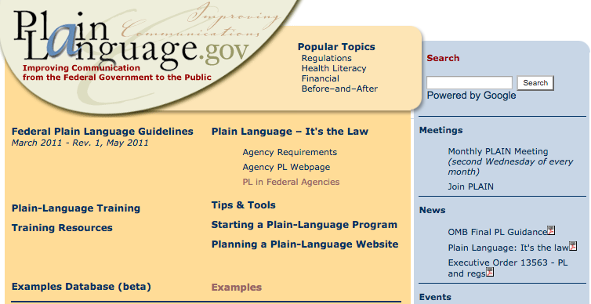
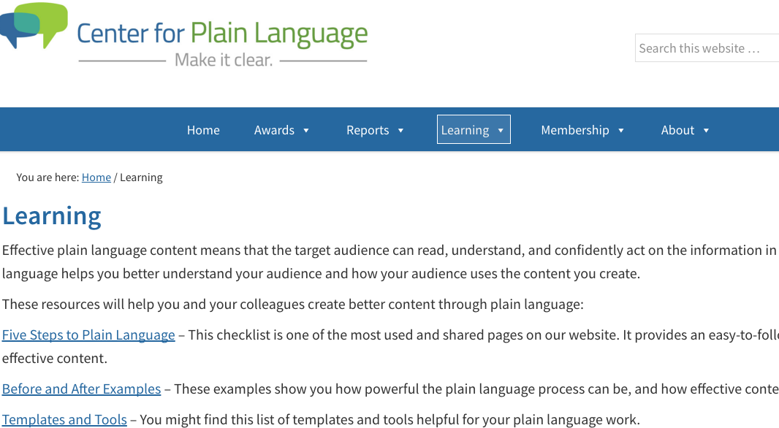
Plain Language Resources
Plainlanguage.gov
Centerforplainlanguage.org

Slide 23
Final Thoughts
“Writing, then, rarely involves the spontaneous production of language; instead, we write and rewrite, revise and edit, arranging and rearranging words. Because writing rests on the page, we have the opportunity to return to it, to tinker with it, to play with it and work on it, before we send it on to a reader. That’s why it makes sense to speak of writing as a craft: we writers begin with the raw material of language and shape it until it expresses something of ourselves—our experiences, observations, and feelings, our ideas and convictions.”
—Nora Bacon, The Well-Crafted Sentence

